Slide 1


Scalable multi-centre research using R and REDCap applications
Kenneth McLean

Slide 2

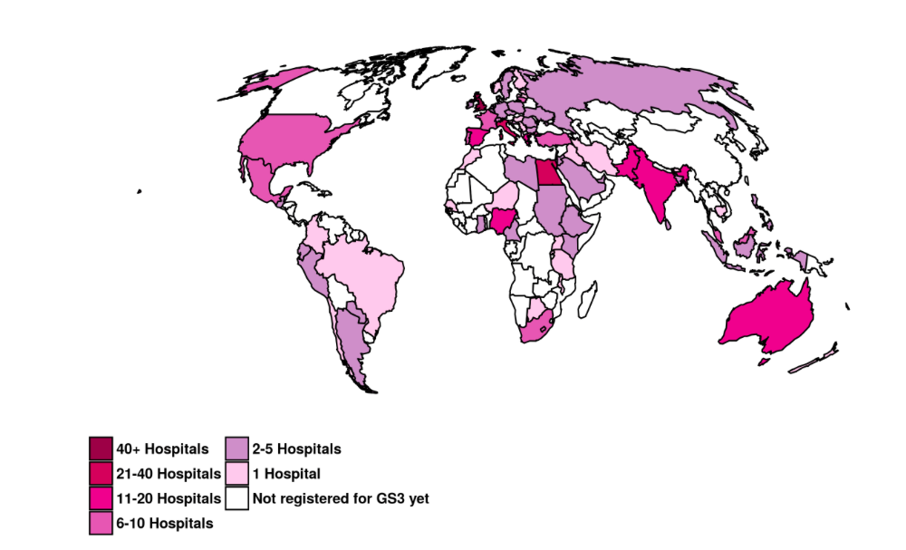
Context
Notes:
Increasingly large studies taking place on national or global scales now include thousands of data collectors (“collaborators”).
These studies have enormous potential to understand and benefit patient care.

Slide 3
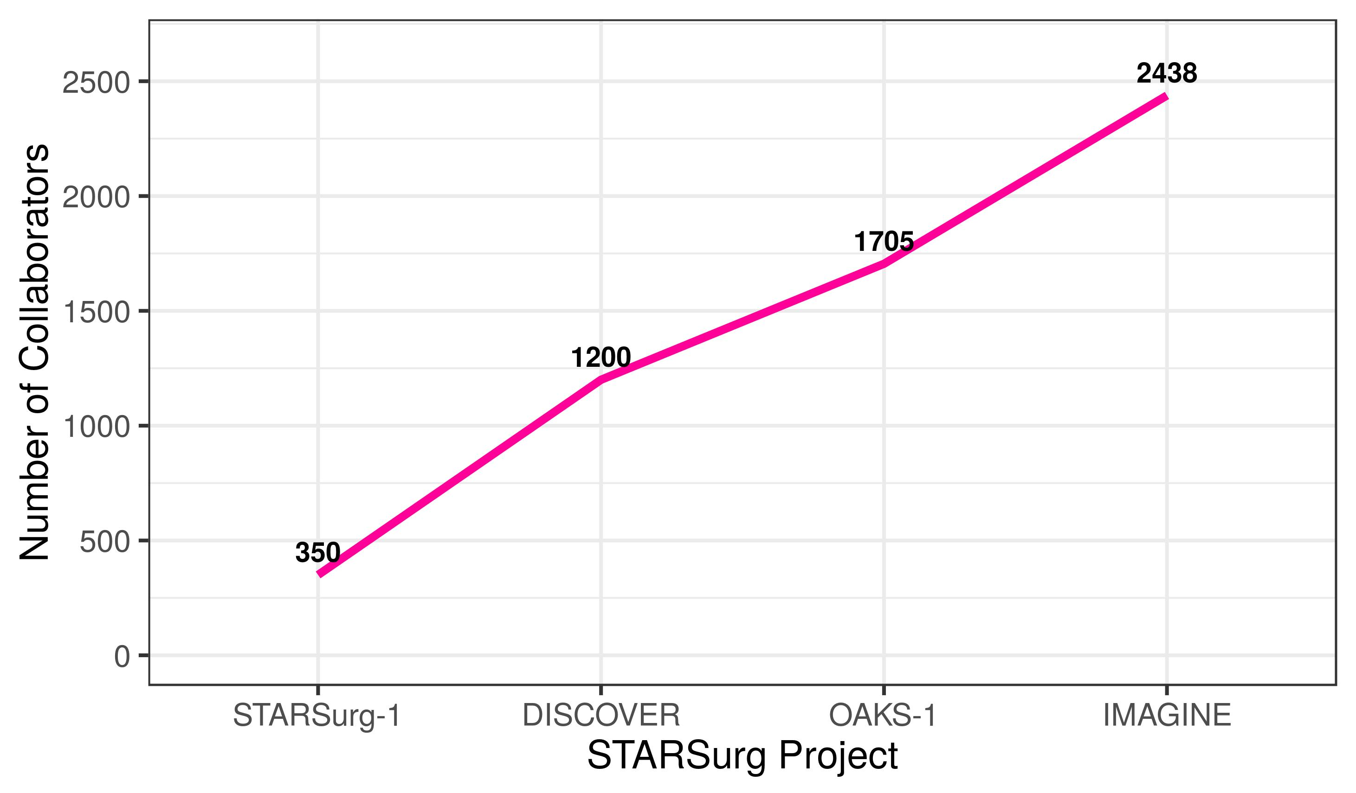

Context
Notes:
STARSurg – a collaborative research group.
My specific issue is that over the space of 4 years for my group, the number of data collectors increased by 700%.

Slide 4
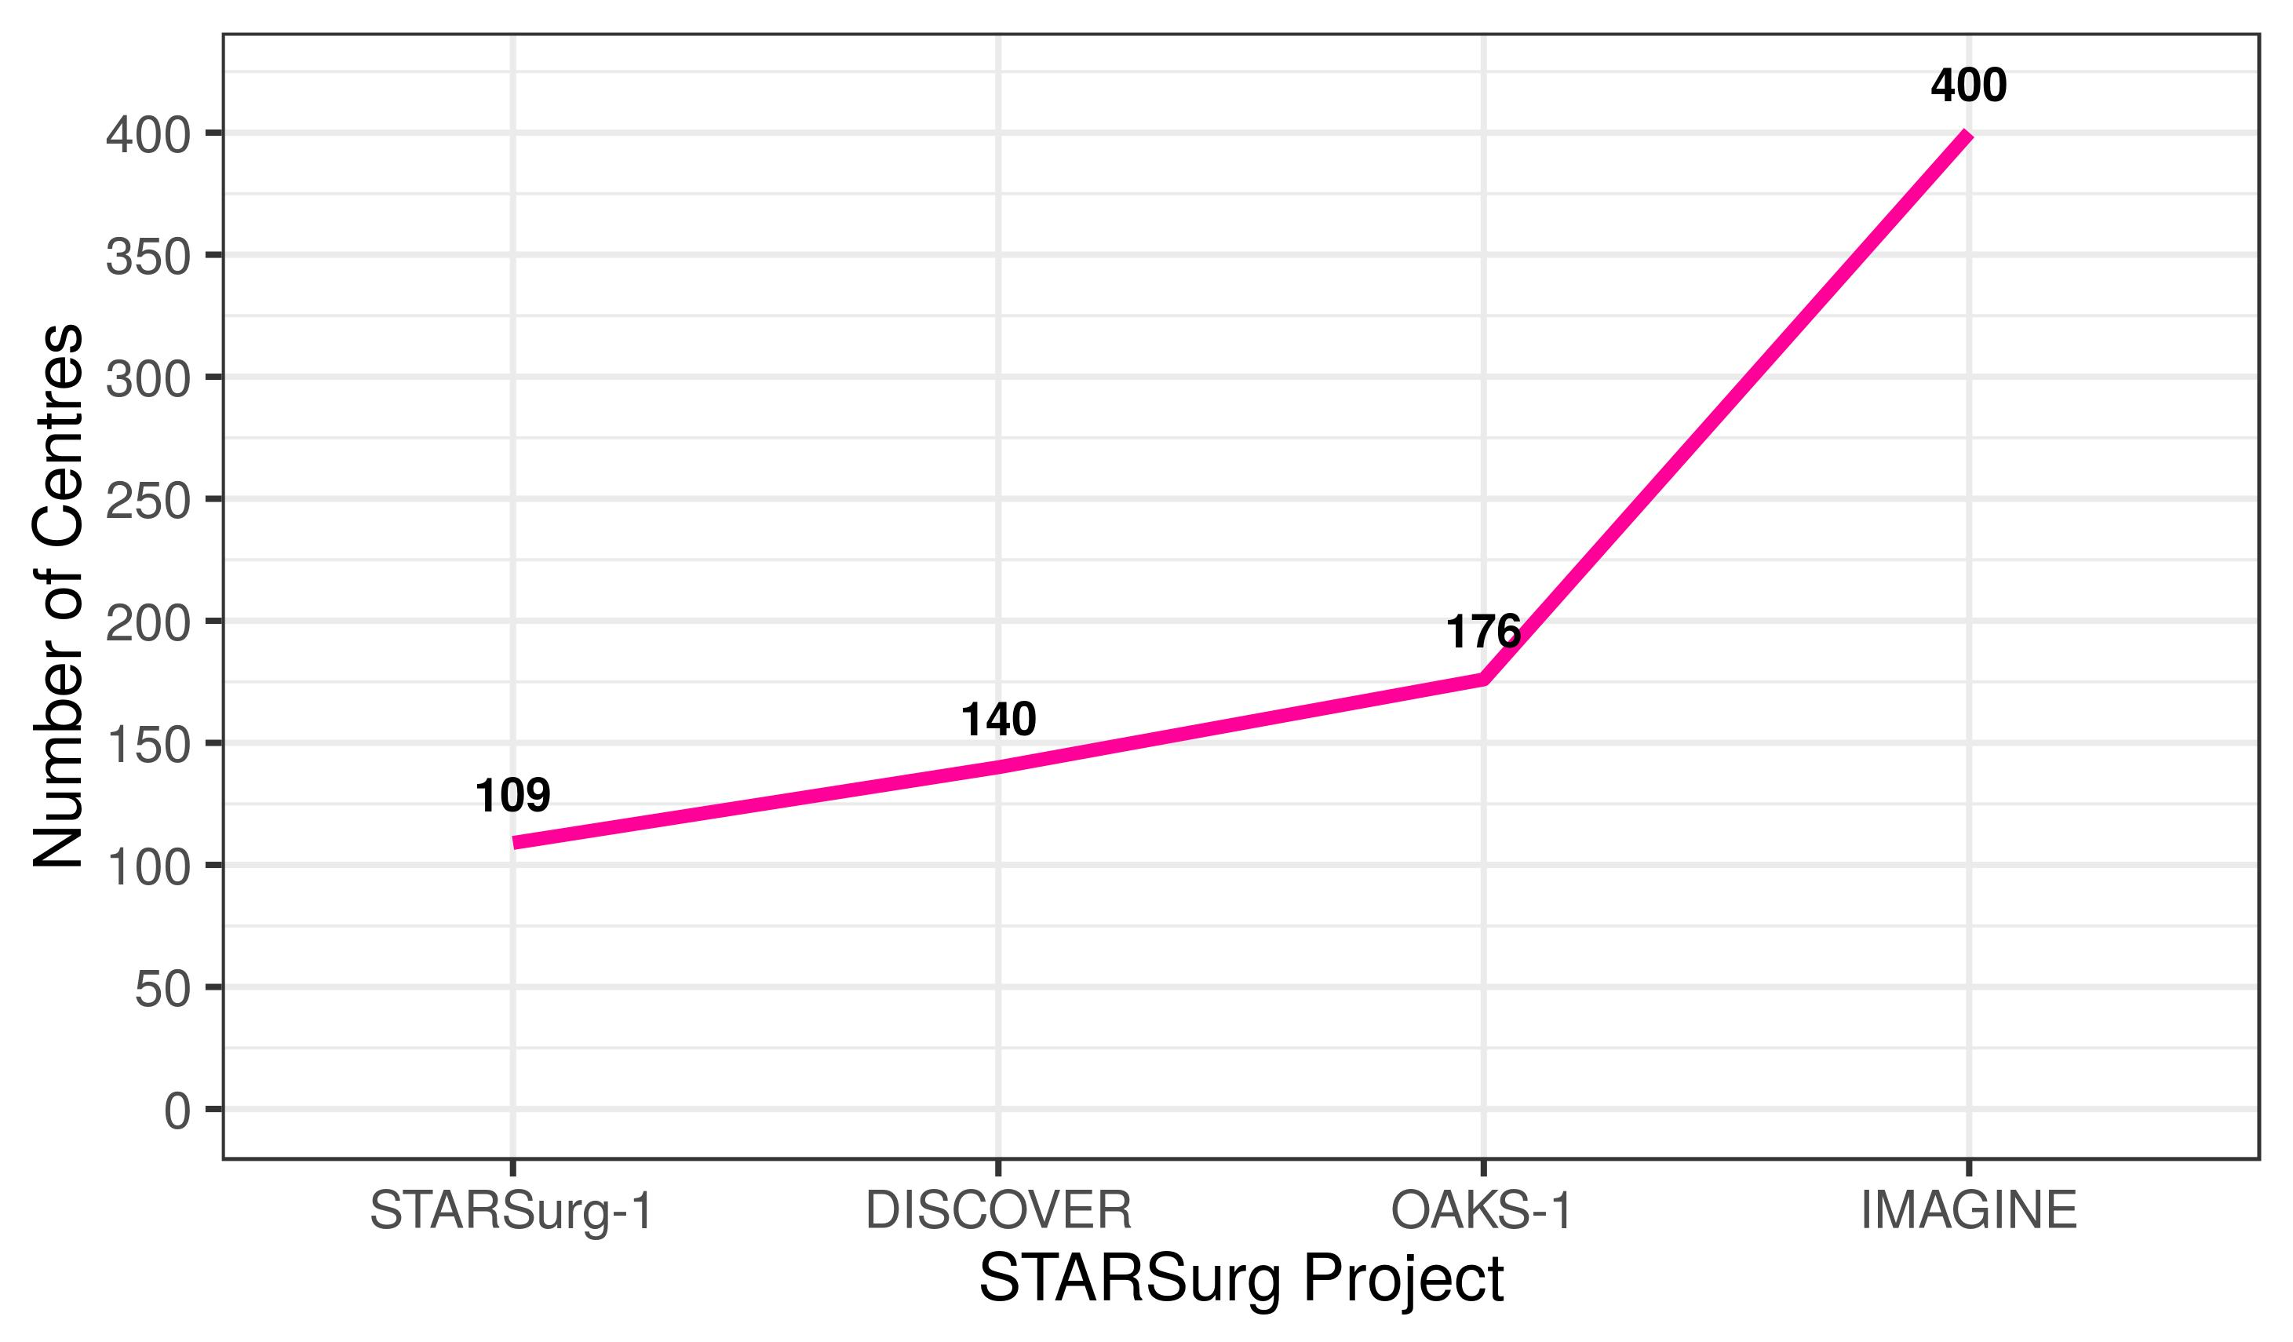
Context
Notes:
Similarly the number of participating hospitals increased by 400%.

Slide 5


Slide 6

REDcap
Platform for data collection & project management.
It is secure, web-based, and user-friendly.

Slide 7
The issue of scalability
REDCap has limitations that become apparent as studies expand (no inbuilt user auto-allocation).
Moreover, other administrative tasks scale with projects (e.g. missing data monitoring).
Without processes to minimise the workload, these can lead to bottlenecks, errors, and suboptimal use of limited resources.

Slide 8


CollaboratoR
This package is designed to simplify and accelerate administration of multi-centre research projects using R and REDCap.
It is generic (applicable to all REDCap projects).
API
Notes:
These functions leverage the REDCap API functionality, and wranges data into useful, informative, and sharable formats.

Slide 9
Data access groups
Data access group (DAG) = hospital.
Restricts users within REDCap database:
Access to patients at their hospital only.
Upload patients at their hospital only.

Slide 10
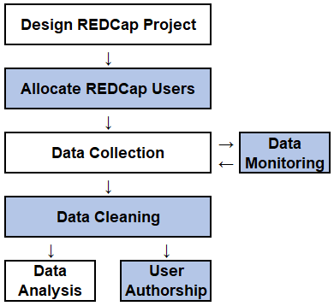
Project Administration
Notes:
About co-ordination

Slide 11
Project Administration
“user_” functions
redcap_sum
report_miss
report_auth

Slide 12
user_assign
Notes:
As I mention, REDCap has no inbuilt way to mass allocate users to their data access group.

Slide 13
Input:
New users to be assigned to the REDCap project
Username | DAG
a_barker | hospital_a
a_hicks | hospital_e
a_lees | hospital_g
a_nicholson | hospital_i
c_avila | NA
c_gould | hospital_b
c_kent | hospital_f
c_michael | hospital_h
f_almond | NA
f_galindo | hospital_a
Current user with desired user rights
“example_user”
Notes:
Requires minimal input: a dataframe of the users and their data access groups + a user uploaded

Slide 14
Function:
user_assign(redcap_project_uri,
redcap_sum(redcap_project_token,
redcap_sum(users.df = new_users,
redcap_sum(role = “example_user”)

Slide 15
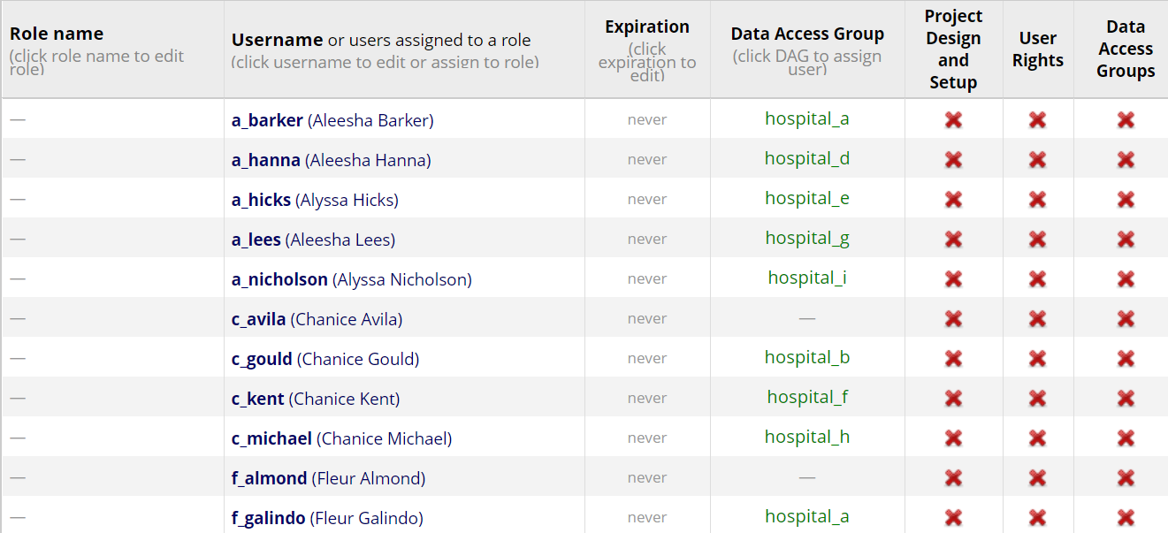
Output: Users auto-assigned
Notes:
Used to push this information directly into redcap – uploading 1000 users (takes 10 hours to upload into 2 min task).

Slide 16
Use
Removes need for manual allocation.
Part of a suite of “user_” functions to support REDCap user administration.
For example:
user_role() → group users by user rights.
user_validate() → checks user allocation.
Notes:
Not only faster, but less labour intensive and less errors.

Slide 17
redcap_sum

Slide 18
Input/Function
redcap_sum(redcap_project_uri,
redcap_sum(redcap_project_token)

Slide 19
Output: Overall Summary
All Records (n) | Complete Records (n) | Proportion Complete | Percent Complete | DAG (n) | Users (n) | Last Updated
50 | 26 | 0.52 | 52.0% | 8 | 30 | 23-Oct-2018

Slide 20
Output: Centre-level Summary
DAG | All Records | Complete Records | Proportion Complete | Users | Last Updated
hospital_a | 10 | 5 | 0.50 | 3 | 23-Oct-2018
hospital_e | 9 | 9 | 1.00 | 3 | 23-Oct-2018
hospital_g | 7 | 4 | 0.57 | 3 | 23-Oct-2018
hospital_b | 6 | 3 | 0.50 | 3 | 23-Oct-2018
hospital_f | 6 | 3 | 0.50 | 3 | 23-Oct-2018
hospital_h | 6 | 2 | 0.33 | 3 | 23-Oct-2018
hospital_d | 4 | 1 | 0.25 | 3 | 23-Oct-2018
hospital_c | 2 | 2 | 1.00 | 2 | 23-Oct-2018
hospital_i | 0 | NA | NA | 3 | 23-Oct-2018
hospital_j | 0 | NA | NA | 4 | 23-Oct-2018

Slide 21
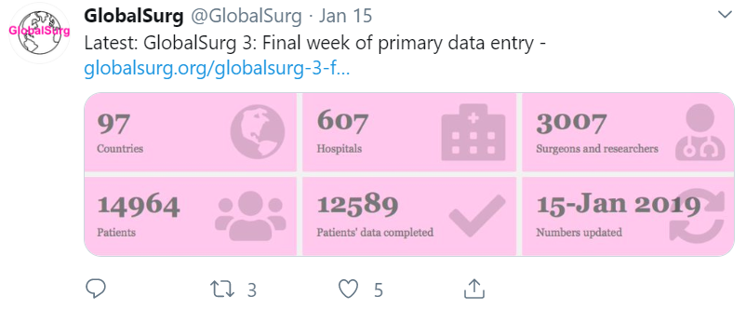
Use
DAG | All Records | Complete Records | Proportion Complete | Users | Last Updated
hospital_i | 0 | NA | NA | 3 | 23-Oct-2018
hospital_j | 0 | NA | NA | 4 | 23-Oct-2018
Notes:
Great for publicity – updating on progress / celebrating top centres.
Real-time data monitoring - identifying centres that might be struggling with data entry to provide more direct support.

Slide 22
report_miss
Notes:
In terms of checking missing data, there are some simple summaries provided by redcap. Report_miss gives a more informative view.

Slide 23
Input/Function
report_miss(redcap_project_uri,
report_miss(redcap_project_token)

Slide 24
Output: Centre-level Report
DAG | Records (n) | Records >5% Data Missing | Missing fields (n) | Total fields (n) | Proportion Missing | Percent Missing
hospital_a | 10 | 5 | 9 | 160 | 0.056 | 5.60%
hospital_b | 6 | 3 | 9 | 96 | 0.094 | 9.40%
hospital_c | 2 | 0 | 0 | 32 | 0.000 | 0.00%
hospital_d | 4 | 3 | 3 | 64 | 0.047 | 4.70%
hospital_e | 9 | 3 | 7 | 144 | 0.049 | 4.90%
hospital_f | 6 | 1 | 1 | 96 | 0.010 | 1.00%
hospital_g | 7 | 3 | 7 | 112 | 0.063 | 6.20%
hospital_h | 6 | 3 | 4 | 96 | 0.042 | 4.20%
Notes:
Importantly, what this function does is only count true missing data (e.g. not data missing due to unfulfilled branching logic questions).

Slide 25
Output: Record-level Report
ID | DAG | Missing data fields (n) | Total data fields (n) | Proportion Missing | Percent Missing | >5% Missing
1 | hospital_a | 0 | 16 | 0 | 0.00% | No
2 | hospital_a | 2 | 16 | 0.125 | 12.50% | Yes
3 | hospital_a | 1 | 16 | 0.0625 | 6.20% | Yes
4 | hospital_a | 0 | 16 | 0 | 0.00% | No
5 | hospital_a | 2 | 16 | 0.125 | 12.50% | Yes
6 | hospital_a | 2 | 16 | 0.125 | 12.50% | Yes
7 | hospital_a | 0 | 16 | 0 | 0.00% | No
8 | hospital_a | 0 | 16 | 0 | 0.00% | No
9 | hospital_a | 2 | 16 | 0.125 | 12.50% | Yes
10 | hospital_a | 0 | 16 | 0 | 0.00% | No
Notes:
At a record level, not only does this give a clear evaluation of the missing data …

Slide 26
Output: Record-level Report (cont.)
ID | DAG | Age | Sex | Smoker | BMI | Operation Date | Follow-up (yes/no) | 30-Day Mortality
1 | hospital_a | . | . | . | . | . | . | .
2 | hospital_a | . | . | M | M | . | . | .
3 | hospital_a | . | . | . | M | . | . | .
4 | hospital_a | . | . | . | . | . | . | .
5 | hospital_a | . | . | . | . | . | . | M
6 | hospital_a | . | . | . | . | . | . | M
7 | hospital_a | . | . | . | . | . | . | .
8 | hospital_a | . | . | . | . | . | . | .
9 | hospital_a | . | . | . | . | . | . | M
10 | hospital_a | . | . | . | . | . | . | .
Notes:
But also supplies an anonomysed dataset with the location of missing data clearly shown.
This can be emailed to users at each hospital to help them easily identify where to focus efforts.

Slide 27
report_auth
Notes:
When at the paper writing stage you want to make sure everyone eligible is on the authorship list.
With 1000s data collectors, this becomes a challenge.

Slide 28
Input: Dataset *
name | hospital | country
Almond S | hospital N | Country 3
Andersen J | hospital E | Country 2
Ashton A | hospital L | Country 3
Avila E | hospital C | Country 3
Ayala N | hospital Q | Country 3
Barker S | hospital D | Country 2
Beech J | hospital N | Country 3
Berry A | hospital A | Country 2
Bowen P | hospital P | Country 3
Bradford J | hospital I | Country 3
*All names have been randomly generated

Slide 29
Function
report_auth(data_author,
report_auth(group = "hospital",
report_auth(subdivision = "country")

Slide 30
Output: Formatted Authorship List
Country 1: Dalby D, Houston M, Morin Y, Stokes P (hospital F); Chamberlain H, Fox B, Keenan L, Mackie L, Plant N (hospital G); Galindo C, Michael P, Prosser E (hospital H); Bradford J, Flores R, Mooney A, Werner R (hospital I). Country 2: Hodge M, Owens I (hospital T); Cervantes S, Marks H, Nicholson L (hospital U); Chung L, Duffy L, Randolph T (hospital V). Country 3: Berry A, Chan K, Gould C, Jensen L (hospital A); Clifford K, Kearns U, Livingston F, Rojas E (hospital B); Avila E, Cullen F, Hanna L, O'Neill L (hospital C); Barker S, Gibbons H, Kent M (hospital D).
Notes:
Each name listed alphabetically by group (hospital), each split by the subdivision (country).
This method works for 10 authors as well as 10,000.

Slide 31




Impact
40k
Patients
10k
Users
600
Centres
97
Countries
Notes:
These functions have been developed and utilised within 5 prospective multicentre cohort studies (to date)
Data collected on 40,000 patients in over 600 centres in nearly 100 countries by 10,000 REDCap users.

Slide 32
Next steps
Ongoing function development:
To enhance communication with redcap users.
To support visualisation of missing data, etc.
Migrate from GitHub → CRAN
Continued dissemination:
Expand portfolio of projects it is used in.
Development of short course.

Slide 33

Next steps
Encourage REDCap to make redundant!
Notes:
CollaboratoR was partly built to address some gaps in REDCap functionality – ideally this would be addressed by REDCap itself.

Slide 34



@kennethmclean92
github.com/kamclean
k.a.mclean@ed.ac.uk

